Slide 1
EE653 Power distribution system modeling, optimization and simulation
ECpE Department
Dr. Zhaoyu Wang
1113 Coover Hall, Ames, IA
wzy@iastate.edu

Slide 2
Distribution Feeder Modeling
and Analysis
Part II. Distribution Feeder Analysis
Acknowledgement: The slides are developed based in part on Distribution System Modeling and Analysis, 4th edition, William H. Kersting, CRC Press, 2017

Slide 3
Distribution Feeder Analysis
The analysis of a distribution feeder will typically consist of a study of the feeder under normal steady-state operating conditions (power-flow analysis) and a study of the feeder under short-circuit conditions (short-circuit analysis).
Both analyses are performed in phase frame.
Models of all of the components of a distribution feeder have been developed in previous chapters. These models will be applied for the analysis under steady-state and short-circuit conditions.
ECpE Department

Slide 4
Applying the Modified Ladder Iterative Technique
We have outlined the steps required for the application of the ladder iterative technique. Forward and backward sweep matrices have been developed for the series devices. By applying these matrices, the computation of the voltage drops along a segment will always be the same regardless of whether the segment represents a line, voltage regulator, or transformer.
In the preparation of data for a power-flow study, it is extremely important that the impedances and admittances of the line segments are computed using the exact spacings and phasing. Because of the unbalanced loading and resulting unbalanced line currents, the voltage drops due to the mutual coupling of the lines become very important. It is not unusual to observe a voltage rise on a lightly loaded phase of a line segment that has an extreme current unbalance.
ECpE Department

Slide 5
Applying the Modified Ladder Iterative Technique
The real power loss in a device can be computed in two ways.
The first method is to compute the power loss in each phase by taking the phase current squared times the total resistance of the phase. Care must be taken to not use the resistance value from the phase impedance matrix. The actual phase resistance that was used in Carson's equations must be used. In developing a computer program, calculating power loss this way requires that the conductor resistance is stored in the active data base for each line segment.
Unfortunately, this method does not give the total power loss in a line segment since the power loss in the neutral conductor and ground are not included. In order to determine the losses in the neutral and ground, we must compute the neutral and ground currents and then the power losses.
ECpE Department

Slide 6
Applying the Modified Ladder Iterative Technique
A second, and preferred, method is to compute power loss as the difference between the real power into a line segment and the real power output of the line segment. Because the effects of the neutral conductor and ground are included in the phase impedance matrix of the total power loss, this method will give the same results as mentioned earlier where the neutral and ground power losses are computed separately.
This method can lead to some interesting numbers for very unbalanced line flows in that it is possible to compute what appears to be a negative phase power loss. This is a direct result of the accurate modeling of the mutual coupling between phases. Remember that the effect of the neutral conductor and the ground resistance is included in Carson's equations.
In reality, there can not be a negative phase power loss. Using this method, the algebraic sum of the line power losses will equal the total three-phase power loss that were computed using the current squared times resistance for the phase and neutral conductors along with the ground current.
ECpE Department

Slide 7
Let’s Put It All Together
At this point the models for all components of a distribution feeder have been developed. The modified ladder iterative technique has also been developed. It is time to put them all together and demonstrate the power-flow analysis of a very simple system. The example below will demonstrate how the models of the components work together in applying the modified ladder technique to achieve a final solution of the operating characteristics of an unbalanced feeder.
ECpE Department

Slide 8
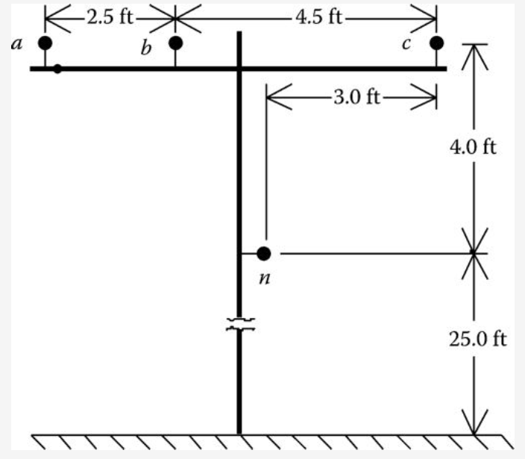
Example
A very simple distribution feeder is shown in Figure 7.
For the system in Fig.7, the infinite bus voltages are balanced three phase of 12.47 kV line to line. The “source” line segment from node 1 to node 2 is a three-wire delta 2000 ft long line and is constructed on the pole configuration of as shown without the neutral. The “load” line segment from node 3 to node 4 is 2500 ft long and also is constructed on the pole configuration as shown but is a four-wire wye so the neutral is included. Both line segments use 336,400 26/7 ACSR phase conductors and the neutral conductor on the four-wire wye line is 4/0 6/1 ACSR. Since the lines are short, the shunt admittance will be neglected. The 25°C resistance is used for the phase and neutral conductors:
$$336,400{26}/7ACSR:resistance at 25℃=0.278 Ω/mile$$
$$4/06/1ACSR:resistance at 25℃=0.445 Ω/mile$$
Fig.7 Example feeder
ECpE Department

Slide 9
Example
The phase impedance matrices for the two line segments are
$\left[{ZeqS}_{ABC}\right]=\left[\begin{matrix}0.1414+j0.5353 & 0.0361+j0.3225 & 0.0361+j0.2572 \\ 0.0361+j0.3225 & 0.1414+j0.5353 & 0.0361+j0.2955 \\ 0.0361+j0.2572 & 0.0361+j0.2955 & 0.1414+j0.5353\end{matrix}\right]$ $Ω$
$\left[{ZeqL}_{abc}\right]=\left[\begin{matrix}0.1907+j0.5035 & 0.0607+j0.2302 & 0.0598+j0.1751 \\ 0.0607+j0.2302 & 0.1939+j0.4885 & 0.0614+j0.1931 \\ 0.0598+j0.1751 & 0.0614+j0.1931 & 0.1921+j0.4970\end{matrix}\right]$ $Ω$
The transformer bank is connected delta–grounded wye and consists of three single-phase transformers each rated:
$$2000 kVA, 12.47−2.4 kV, Z=1.0+j6.0\%$$
The feeder serves an unbalanced three-phase wye-connected constant PQ load of
$$S_{a}=750 kVA at 0.85 lagging power factor$$
$$S_{b}=1000 kVA at 0.90 lagging power factor$$
$$S_{c}=1230 kVA at 0.95 lagging power factor$$
ECpE Department

Slide 10
Example
Before starting the iterative solution, the forward and backward sweep matrices must be computed for each series element. The modified ladder method is going to be employed so only the [A], [B], and [d] matrices need to be computed.
Source line segment with shunt admittance neglected:
[$U$]=$\left[\begin{matrix}1 & 0 & 0 \\ 0 & 1 & 0 \\ 0 & 0 & 1\end{matrix}\right]$
$\left[A_{1}\right]=$[$U$]=$\left[\begin{matrix}1 & 0 & 0 \\ 0 & 1 & 0 \\ 0 & 0 & 1\end{matrix}\right]$
$$\left[B_{1}\right]=\left[{ZeqS}_{ABC}\right]=\left[\begin{matrix}0.1414+j0.5353 & 0.0361+j0.3225 & 0.0361+j0.2572 \\ 0.0361+j0.3225 & 0.1414+j0.5353 & 0.0361+j0.2955 \\ 0.0361+j0.2572 & 0.0361+j0.2955 & 0.1414+j0.5353\end{matrix}\right]$$
$\left[d_{1}\right]=$[$U$]=$\left[\begin{matrix}1 & 0 & 0 \\ 0 & 1 & 0 \\ 0 & 0 & 1\end{matrix}\right]$
ECpE Department

Slide 11
Example
Load line segment:
$\left[A_{2}\right]=$[$U$]=$\left[\begin{matrix}1 & 0 & 0 \\ 0 & 1 & 0 \\ 0 & 0 & 1\end{matrix}\right]$
$$\left[B_{2}\right]=\left[{ZeqL}_{abc}\right]=\left[\begin{matrix}0.1907+j0.5035 & 0.0607+j0.2302 & 0.0598+j0.1751 \\ 0.0607+j0.2302 & 0.1939+j0.4885 & 0.0614+j0.1931 \\ 0.0598+j0.1751 & 0.0614+j0.1931 & 0.1921+j0.4970\end{matrix}\right]$$
$\left[d_{2}\right]=$[$U$]=$\left[\begin{matrix}1 & 0 & 0 \\ 0 & 1 & 0 \\ 0 & 0 & 1\end{matrix}\right]$
ECpE Department

Slide 12
Example
Transformer:
The transformer impedance must be converted to actual value in Ohms referenced to the low-voltage windings.
$$Z_{base}=\frac{{2.4}^{2}∙1000}{2000}=2.88 Ω$$
${Zt}_{low}=(0.01+j0.06)∙2.88$ $=0.0288+j0.1728 Ω$
The transformer phase impedance matrix is
$$\left[{Zt}_{abc}\right]=\left[\begin{matrix}0.0228+j0.1728 & 0 & 0 \\ 0 & 0.0228+j0.1728 & 0 \\ 0 & 0 & 0.0228+j0.1728\end{matrix}\right]$$
ECpE Department

Slide 13
Example
The “turns” ratio: n_{t} = 12.47/2.4 = 5.1958.
$$\left[A_{t}\right]=\frac{1}{n_{t}}∙\left[\begin{matrix}1 & 0 & −1 \\ −1 & 1 & 0 \\ 0 & −1 & 1\end{matrix}\right]=\left[\begin{matrix}0.1925 & 0 & −0.1925 \\ −0.1925 & 0.1925 & 0 \\ 0 & −0.1925 & 0.1925\end{matrix}\right]$$
$$\left[B_{t}\right]=\left[{Zt}_{abc}\right]=\left[\begin{matrix}0.0228+j0.1728 & 0 & 0 \\ 0 & 0.0228+j0.1728 & 0 \\ 0 & 0 & 0.0228+j0.1728\end{matrix}\right]$$
$$\left[d_{t}\right]=\frac{1}{n_{t}}∙\left[\begin{matrix}1 & −1 & 0 \\ 0 & 1 & −1 \\ −1 & 0 & 1\end{matrix}\right]=\left[\begin{matrix}0.1925 & −0.1925 & 0 \\ 0 & 0.1925 & −0.1925 \\ −0.1925 & 0 & 0.1925\end{matrix}\right]$$
Define the node 4 loads:
$$\left[S4\right]=\left[\begin{aligned}750∠acos⁡(0.85) \\ 1000∠acos⁡(0.90) \\ 1250∠acos⁡(0.95)\end{aligned}\right]=\left[\begin{aligned}750∠31.79 \\ 1000∠25.84 \\ 1250∠18.19\end{aligned}\right] kVA$$
Define infinite bus line-to-line and line-to-neutral voltages:
$$\left[{ELL}_{s}\right]=\left[\begin{aligned}12,470∠30 \\ 12,470∠−90 \\ 12,470∠150\end{aligned}\right] V$$
$$\left[{ELN}_{s}\right]=\left[\begin{aligned}7199.6∠0 \\ 7199.6∠−120 \\ 7199.6∠120\end{aligned}\right] V$$
ECpE Department

Slide 14
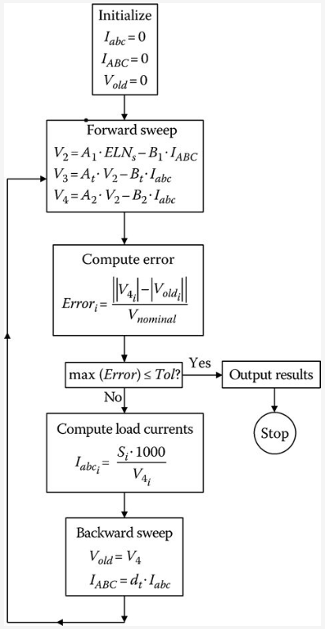
Example
The flowchart of a Mathcad® program is shown in Fig.8.
The Mathcad program is used to analyze the system, and, after eight iterations, the load voltages on a 120 V base are
$$\left[{V4}_{120}\right]=\left[\begin{aligned}113.9 \\ 110.0 \\ 110.6\end{aligned}\right] V$$
Update nodal injection currents (loads, capacitors, ….) before moving to backward sweep.
Fig.8 Flowchart
ECpE Department

Slide 15
Example
The voltages at node 4 are below the desired 120 V. These low voltages can be corrected with the installation of three step-voltage regulators connected in wye on the secondary bus (node 3) of the transformer. The new configuration of the feeder is shown in Fig.9.
For the regulator, the potential transformer ratio will be 2400–120 V (N_{pt} = 20) and the CT ratio is selected to carry the rated current of the transformer bank. The rated current is
$$I_{rated}=\frac{6000}{\sqrt{3}∙2.4}=832.7$$
The CT ratio is selected to be 1000 : 5 = CT = 200.
Fig.9 Voltage regulator added to this system
ECpE Department

Slide 16
Example
For the regulator, the potential transformer ratio will be 2400–120 V (N_{pt} = 20) and the CT ratio is selected to carry the rated current of the transformer bank. The rated current is
$${Zeq}_{i}=\frac{{V3}_{i}−{V4}_{i}}{{I3}_{i}}=\left[\begin{aligned}0.1414+j0.1830 \\ 0.2079+j0.2827 \\ 0.0889+j0.3833\end{aligned}\right] Ω$$
The three regulators are to have the same R and X compensator settings. The average value of the computed impedances will be used:
$$Z_{avg}=\frac{1}{3}∙\sum_{k=1}^{3}{{Zeq}_{k}=0.1451+j0.2830 Ω}$$
The value of the compensator impedance in volts is given as
$$R^{′}+jX^{′}=\left(0.1451+j0.2830\right)∙\frac{1000}{20}=7.3+j14.2 V$$
The value of the compensator settings in Ohms is
$R_{Ω}+jX_{Ω}=\frac{7.3+j14.2}{5}=1.46+j2.84$ $Ω$
ECpE Department

Slide 17
Example
With the regulator in the neutral position, the voltages being input to the compensator circuit for the given conditions are
$${Vreg}_{i}=\frac{{V3}_{i}}{PT}=\left[\begin{aligned}117.5∠−31.2 \\ 117.1∠−151.7 \\ 116.7∠87.8\end{aligned}\right] V$$
The compensator currents are
$${Icomp}_{i}=\frac{{labc}_{i}}{CT}=\left[\begin{aligned}1.6460∠−63.6 \\ 2.2727∠−179.4 \\ 2.8264∠64.9\end{aligned}\right] A$$
With the input voltages and compensator currents, the voltages across the voltage relays in the compensator circuit are computed to be
$$\left[V_{relay}\right]=\left[V_{reg}\right]−\left[Z_{comp}\right]∙\left[I_{comp}\right]=\left[\begin{aligned}113.0∠−32.5 \\ 111.3∠−153.8 \\ 109.0∠84.5\end{aligned}\right] V$$
Notice how close these compare to the actual voltages on a 120 V base at node 4.
ECpE Department

Slide 18
Example
Assume that the voltage level has been set at 121 V with a bandwidth of 2 V. In the real world, the regulators on each phase will change taps one at a time until the relay on that phase reaches 120 V. In order to model this system, the flowchart of Fig.8 is slightly modified in the forward and backward sweeps.
Forward sweep:
$$\left[{VLN}_{2}\right]=\left[A_{1}\right]∙\left[E_{s}\right]−\left[B_{1}\right]∙\left[I_{ABC}\right]$$
$$\left[{VLN}_{3r}\right]=\left[A_{t}\right]∙\left[{VLN}_{2}\right]−\left[B_{t}\right]∙\left[I_{in}\right]$$
(9.a)
$$\left[{VLN}_{3}\right]=\left[A_{reg}\right]∙\left[{VLN}_{3}\right]−\left[B_{reg}\right]∙\left[I_{abc}\right]$$
$$\left[{VLN}_{4}\right]=\left[A_{2}\right]∙\left[{VLN}_{3}\right]−\left[B_{2}\right]∙\left[I_{abc}\right]$$
Backward sweep:
$$\left[V_{old}\right]=\left[{VLN}_{4}\right]$$
$$\left[I_{in}\right]=\left[d_{reg}\right]∙\left[I_{abc}\right]$$
(9.b)
$$\left[I_{ABC}\right]=\left[d_{t}\right]∙\left[I_{in}\right]$$
ECpE Department

Slide 19
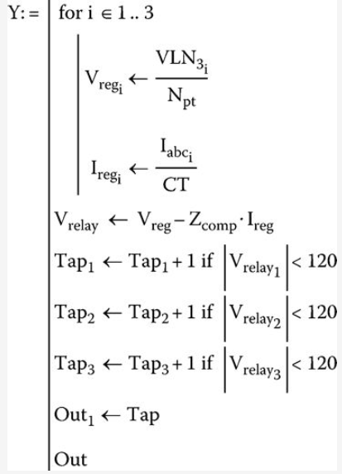
Example
After the analysis routine has converged, a new routine will compute whether or not tap changes need to be made. The Mathcad routine for computing the new taps is shown in Fig.10.
Fig.10 Tap changing routine
ECpE Department

Slide 20
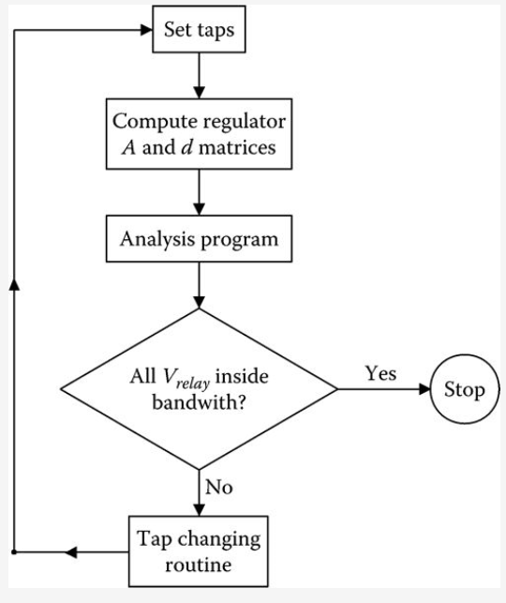
Example
The computational sequence for the determination of the final tap settings and convergence of the system is shown in the flowchart of Fig.11.
Fig.11 Computational sequence
ECpE Department

Slide 21
Example
The tap changing routine changes individual regulators one step at a time. The final tap settings are
$$[Tap]=\left[\begin{aligned}9 \\ 11 \\ 12\end{aligned}\right]$$
The final relay voltages are
$$[V_{relay}]=\left[\begin{aligned}120.3 \\ 120.4 \\ 120.1\end{aligned}\right]$$
The final voltages on a 120 V base at the load center (node 4) are
$$[{VLN}_{4_{120}}]=\left[\begin{aligned}121.0 \\ 119.3 \\ 120.7\end{aligned}\right]$$
Unlike the previous example, the compensator relay voltages and the actual load center voltages are very close to each other.
ECpE Department

Slide 22
Load Allocation
Many times the input complex power (kW and kvar) to a feeder is known because of the metering at the substation. This information can be for either total three phases or each individual phase. In some cases, the metered data may be the current and power factor in each phase.
It is desirable to force the computed input complex power to the feeder matching the metered input. This can be accomplished (following a converged iterative solution) by computing the ratio of the metered input to the computed input. The phase loads can now be modified by multiplying the loads by this ratio. Because the losses of the feeder will change when the loads are changed, it is necessary to go through the ladder iterative process to determine a new computed input to the feeder. This new computed input will be closer to the metered input but most likely not within a specified tolerance. Again a ratio can be determined and the value of the loads modified. This process is repeated until the computed input is within a specified tolerance of the metered input.
Load allocation does not have to be limited to matching metered readings just at the substation. The same process can be performed at any point on the feeder where metered data is available. The only difference is that now only the “downstream” nodes from the metered point will be modified.
ECpE Department

Slide 23
Per-unit Analysis of Power-Flow Studies
The development of the models and examples uses actual values of voltage, current, impedance, and complex power.
When per-unit values are used, it is imperative that all values be converted to per unit using a common set of base values. In the usual application of per unit, there will be a base line-to-line voltage and a base line-to-neutral voltage; also, there will be a base line current and a base delta current. For both the voltage and current, there is a square root of three relationship between the two base values. In all of the derivations of the models, and, in particular, those for the three-phase transformers, the square root of three has been used to relate the difference in magnitudes between line-to-line and line-to-neutral voltages and between the line and delta currents. Because of this, when using the per-unit system, there should be only one base voltage and that should be the base line-to-neutral voltage.
When this is done, for example, the per-unit positive and negative sequence voltages will be the square root of three times the per-unit positive and negative sequence line-to-neutral voltages. Similarly, the positive and negative sequence per-unit line currents will be the square of three times the positive and negative sequence per-unit delta currents. By using just one base voltage and one base current, the per-unit generalized matrices for all system models can be determined.
ECpE Department

Slide 24
Summary of Power-Flow Studies
This section has developed a method for performing power-flow studies on a distribution feeder. Models for the various components of the feeder have been developed in previous chapters.
The purpose of this section has been to develop and demonstrate the modified ladder iterative technique using the forward and backward sweep matrices for the series elements.
It should be obvious that a study of a large feeder with many laterals and sublaterals can not be performed without the aid of a complex computer program.
ECpE Department

Slide 25
Short-Circuit Studies
The computation of short-circuit currents for unbalanced faults in a normally balanced three-phase system has traditionally been accomplished by the application of symmetrical components.
However, this method is not well suited to a distribution feeder that is inherently unbalanced. The unequal mutual coupling between phases leads to mutual coupling between sequence networks. When this happens, there is no advantage in using symmetrical components. Another reason for not using symmetrical components is that the phases between which faults occur is limited. For example, using symmetrical components, line-to-ground faults are limited to phase a to ground. What happens if a single-phase lateral is connected to phase b or c and the short-circuit current is needed?
This section develops a method for short-circuit analysis of an unbalanced three-phase distribution feeder using the phase frame.
ECpE Department

Slide 26
General Theory
Fig.12 shows the unbalanced feeder as modeled for short-circuit calculations.
Short circuits can occur at any one of the five points shown in Fig.12. Point 1 is the high-voltage bus of the distribution substation transformer. The values of the short-circuit currents at point 1 are normally determined from a transmission system short-circuit study. (This means if point 1 has a fault, it should be analyzed as a part of transmission systems using sequence analysis.) The results of these studies are supplied in terms of the three-phase and single-phase short-circuit MVAs (Megavolt amperes). Using the short-circuit MVAs, the positive and zero sequence impedances of the equivalent system can be determined. These values are needed for the short-circuit studies at the other four points in Fig.12.
Fig.12 Unbalanced feeder short-circuit analysis model
ECpE Department

Slide 27
General Theory
Given the three-phase short-circuit MVA magnitude and angle, the positive sequence equivalent system impedance in Ohms is determined by
$Z_{+}=\frac{{KLL}^{2}}{{\left({MVA}_{3−phase}\right)}^{∗}}$ $Ω$
(10)
Given the single-phase short-circuit MVA magnitude and angle, the zero sequence equivalent system impedance in Ohms is determined by
$Z_{0}=\frac{{3∙KLL}^{2}}{{\left({MVA}_{1−phase}\right)}^{∗}}−2Z_{+}$ $Ω$
(11)
In Equations 10 and 11, kVLL is the nominal line-to-line voltage in kV of the transmission system.
The computed positive and zero sequence impedances need to be converted into the phase impedance matrix using the symmetrical component transformation matrix defined as follows:
$$\left[Z_{012}\right]=\left[\begin{matrix}Z_{0} & 0 & 0 \\ 0 & Z_{1} & 0 \\ 0 & 0 & Z_{2}\end{matrix}\right]$$
$$\left[Z_{abc}\right]=\left[A_{s}\right]∙\left[Z_{012}\right]{∙\left[A_{s}\right]}^{−1}$$
(12)
ECpE Department

Slide 28
General Theory
For short circuits at points 2 through 5 (these are in distribution systems), it is going to be necessary to compute the Thevenin equivalent three-phase circuit at the short-circuit point.
The Thevenin equivalent voltages will be the nominal line-to-ground voltages with the appropriate angles. For example, the equivalent system line-to-ground voltages are balanced three phase of nominal voltage with the phase a voltage at 0°. (This is to assume the infinite bus balanced L-G voltages). The Thevenin equivalent voltages at points 2 and 3 will be computed by multiplying the system voltages by the generalized transformer matrix [A_{t}] of the substation transformer (here the transformer internal impendences are rounded into the Thevenin equivalent impedance as shown below). Carrying this further, the Thevenin equivalent voltages at points 4 and 5 will be the voltages at node 3 multiplied by the generalized matrix [A_{t}] for the in-line transformer.
The Thevenin equivalent phase impedance matrices will be the sum of the phase impedance matrices of each device between the system voltage source and the point of fault. Step-voltage regulators are assumed to be set in the neutral position so they do not enter into the short-circuit calculations. Anytime that a three-phase transformer is encountered, the total phase impedance matrix on the primary side of the transformer must be referred to the secondary side.
ECpE Department

Slide 29
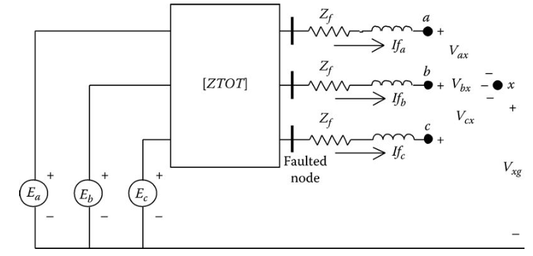
General Theory
Fig.13 illustrates the Thevenin equivalent circuit at the faulted node [3].
In Fig.13, the voltage sources E_{a}, E_{b}, and E_{c} represent the Thevenin equivalent line-to-ground voltages at the faulted node; the matrix [ZTOT] represents the Thevenin equivalent phase impedance matrix at the faulted node; and Z_{f} represents the fault impedance.
Fig.13 Thevenin equivalent circuit
[3] Kersting, W.H. and Phillips, W.H., Distribution system short-circuit analysis, 25th Intersociety Energy Conversion Engineering Conference, Reno, NV, August 12–17, 1990
ECpE Department

Slide 30
General Theory
KVL in matrix form can be applied to the circuit of Fig.13:
$\left[\begin{aligned}E_{a} \\ E_{b} \\ E_{c}\end{aligned}\right]$ $=\left[\begin{matrix}Z_{aa} & Z_{ab} & Z_{ac} \\ Z_{ba} & Z_{bb} & Z_{bc} \\ Z_{ca} & Z_{cb} & Z_{cc}\end{matrix}\right] ∙\left[\begin{aligned}{If}_{a} \\ {If}_{b} \\ {If}_{c}\end{aligned}\right]−\left[\begin{matrix}Z_{f} & 0 & 0 \\ 0 & Z_{f} & 0 \\ 0 & 0 & Z_{f}\end{matrix}\right] ∙\left[\begin{aligned}{If}_{a} \\ {If}_{b} \\ {If}_{c}\end{aligned}\right]+\left[\begin{aligned}V_{ax} \\ V_{bx} \\ V_{cx}\end{aligned}\right]+\left[\begin{aligned}V_{xg} \\ V_{xg} \\ V_{xg}\end{aligned}\right]$
(13)
Equation (13) can be written in compressed form as
$\left[E_{abc}\right]$ $=\left[ZTOT\right] ∙\left[{If}_{abc}\right]−\left[ZF\right] ∙\left[{If}_{abc}\right]+\left[V_{abcx}\right]+\left[V_{xg}\right]$
(14)
Combine terms in Equation (14):
$\left[E_{abc}\right]$ $=\left[ZEQ\right] ∙\left[{If}_{abc}\right]+\left[V_{abcx}\right]+\left[V_{xg}\right]$
(15)
where
$$\left[ZEQ\right]=\left[ZTOT\right]+\left[ZF\right]$$
(16)
Solve Equation (15) for the fault currents:
$$\left[{If}_{abc}\right]=\left[Y\right]∙\left[E_{abc}\right]−\left[Y\right]∙\left[V_{abcx}\right]−\left[Y\right]∙\left[V_{xg}\right]$$
(17)
where
$${\left[Y\right]=\left[ZEQ\right]}^{−1}$$
(18)
ECpE Department

Slide 31
General Theory
Since the matrices [Y] and [E_{abc}] are known, define
$$\left[{IP}_{abc}\right]=\left[Y\right]∙\left[E_{abc}\right]$$
(19)
$$\left[{If}_{abc}\right]=\left[Y\right]∙\left[E_{abc}\right]−\left[Y\right]∙\left[V_{abcx}\right]−\left[Y\right]∙\left[V_{xg}\right]$$
(17)
Substituting Equation (19) into Equation (17) and rearranging result in
(20)
$$\left[{IP}_{abc}\right]=\left[{If}_{abc}\right]+\left[Y\right]∙\left[V_{abcx}\right]+\left[Y\right]∙\left[V_{xg}\right]$$
Expanding Equation (20),
$\left[\begin{aligned}{IP}_{a} \\ {IP}_{b} \\ {IP}_{c}\end{aligned}\right]$ $=\left[\begin{aligned}{If}_{a} \\ {If}_{b} \\ {If}_{c}\end{aligned}\right]+\left[\begin{matrix}Y_{aa} & Y_{ab} & Y_{ac} \\ Y_{ba} & Y_{bb} & Y_{bc} \\ Y_{ca} & Y_{cb} & Y_{cc}\end{matrix}\right] ∙\left[\begin{aligned}V_{ax} \\ V_{bx} \\ V_{cx}\end{aligned}\right]+\left[\begin{matrix}Y_{aa} & Y_{ab} & Y_{ac} \\ Y_{ba} & Y_{bb} & Y_{bc} \\ Y_{ca} & Y_{cb} & Y_{cc}\end{matrix}\right] ∙\left[\begin{aligned}V_{xg} \\ V_{xg} \\ V_{xg}\end{aligned}\right]$
(21)
Performing the matrix operations in Equation (21),
${IP}_{a}={If}_{a}+$($Y_{aa}∙V_{ax}+Y_{ab}∙V_{bx}+Y_{ac}∙V_{cx}$)$+Y_{S_{a}}{∙V}_{xg}$
${IP}_{b}={If}_{b}+$($Y_{ba}∙V_{ax}+Y_{bb}∙V_{bx}+Y_{bc}∙V_{cx}$)$+Y_{S_{b}}{∙V}_{xg}$
(22)
${IP}_{c}={If}_{c}+$($Y_{ca}∙V_{ax}+Y_{cb}∙V_{bx}+Y_{cc}∙V_{cx}$)$+Y_{S_{c}}{∙V}_{xg}$
where
$$Y_{S_{a}}=Y_{aa}+Y_{ab}+Y_{ac}$$
$$Y_{S_{b}}=Y_{ba}+Y_{bb}+Y_{bc}$$
(23)
$$Y_{S_{c}}=Y_{ca}+Y_{cb}+Y_{cc}$$
ECpE Department

Slide 32
General Theory
${IP}_{a}={If}_{a}+$($Y_{aa}∙V_{ax}+Y_{ab}∙V_{bx}+Y_{ac}∙V_{cx}$)$+Y_{S_{a}}{∙V}_{xg}$
${IP}_{b}={If}_{b}+$($Y_{ba}∙V_{ax}+Y_{bb}∙V_{bx}+Y_{bc}∙V_{cx}$)$+Y_{S_{b}}{∙V}_{xg}$
(22)
${IP}_{c}={If}_{c}+$($Y_{ca}∙V_{ax}+Y_{cb}∙V_{bx}+Y_{cc}∙V_{cx}$)$+Y_{S_{c}}{∙V}_{xg}$
Equations (22) become the general equations that are used to simulate all types of short circuits. Basically, there are three equations and seven unknowns (If_{a}, If_{b}, If_{c}, V_{ax}, V_{bx}, V_{cx}, and V_{xg}). The other three variables in the equations (IP_{a}, IP_{b}, and IP_{c}) are functions of the total impedance and the Thevenin voltages and are therefore known. In order to solve Equations (22), it will be necessary to specify four additional independent equations. These equations are functions of the type of fault being simulated. The additional required four equations for various types of faults are given in the following.
These values are determined by placing short circuits in Fig.13 to simulate the particular type of fault. For example, a three-phase fault is simulated by placing a short circuit from node a to x, node b to x, and node c to x. That gives three voltage equations. The fourth equation comes from applying KCL at node x, which gives the sum of the fault currents to be zero.
ECpE Department

Slide 33
Specific Short Circuits
Three-phase faults:
$$V_{ax}=V_{bx}=V_{cx}=0$$
$$I_{a}+I_{b}+I_{c}=0$$
(24)
Three-phase-to-ground faults:
$$V_{ax}=V_{bx}=V_{cx}=V_{xg}=0$$
(25)
Line-to-line faults (assume i–j fault with phase k unfaulted):
$$V_{ix}=V_{jx}=0$$
$${If}_{a}=0$$
$${If}_{i}+{If}_{j}=0$$
(26)
Line-to-line-to-ground faults (assume i–j–g fault with phase k unfaulted):
$$V_{ix}=V_{jx}=0$$
$$V_{xg}=0$$
$$I_{k}=0$$
(27)
Line-to-ground faults (assume phase k fault with phases i and j unfaulted):
$$V_{kx}=V_{xg}=0$$
$${If}_{i}={If}_{j}=0$$
(28)
Note that Equations (26) through (28) will allow the simulation of line-to-line faults, line-to-line-to-ground, and line-to-ground faults for all phases. There is no limitation to b–c faults for line to line and a–g for line to ground as is the case when the method of symmetrical components is employed.
ECpE Department

Slide 34
Specific Short Circuits
A good way to solve the seven equations is to set them up in matrix form:
(29)
Equation (29) in condensed form:
$$\left[{IP}_{s}\right]=\left[C\right]∙\left[X\right]$$
(30)
Equation (30) can be solved for the unknowns in matrix [X]:
$$\left[X\right]={\left[C\right]}^{−1}∙\left[{IP}_{s}\right]$$
(31)
The blanks in the last four rows of the coefficient matrix in Equation (29) are filled in with the known variables depending upon what type of fault is to be simulated. For example, the elements in the [C] matrix simulating a three-phase fault would be
$$C_{4,4}=C_{5,5}=C_{6,6}=1$$
$$C_{7,1}=C_{7,2}=C_{7,3}=1$$
All of the other elements in the last four rows will be set to zero.
ECpE Department

Slide 35
Thank You!
ECpE Department

